Slide 1
First Session of Bangladesh Urban Forum Towards Bangladesh’ Resilient Cities: Climate Change, Environment and Disaster Mitigation
06 December, BICC, Sher-e-Bangla Nagar
Contributors: Dr. AQM Mahbub; Dr. M.Shahidul Islam;
Dr. Maksudul Kamal, Iftekhar Enayetullah and Dr. Aminul Islam
Contribution made through solution exchange network:
AHM Rezaul Kabir; Rezaur Rahman;; Dr. Mahbuba Nasrin; Shaila Shahid; Steven Goldfinch; Dilruba Haider; Tofail Md Alamgir Azad and Khurshid Alam

Slide 2
Structure of the Presentation
Strategic Context and Problem
Climate change, environment and disaster risk issues, threats and challenges
Urban Governance
Sustainable Climate resilience Cities & Population Migration
Urban Risk Reduction
Public-Private Partnership for Urban Sustainability
Way Forward

Slide 3
Strategic Context and Problem
Megacities, secondary, small growing towns and coastal urban centres of Bangladesh are subjected to climate change, environmental hazards and disaster risks.
Effects of climate change, environmental degradation and disaster further threaten the lives, livelihoods, assets, environmental quality and economic gains of city dwellers particularly the urban poor.
Policy and planning are not adequately responsive to the dynamic interrelations and the combined impacts of climate change, environment and disaster risk (CCED) in the different sectors, socio-economic strata of population, and hazard specific geographical areas.

Slide 4
Climate change, environment and disaster risk issues, threats and challenges
Bangladesh as whole is vulnerable to climate change, but as a region the coastal belt of Bangladesh is the most vulnerable part of the country because of human induced and climate change related hazards.
To address the spatial characteristics of coastal dynamics and cope with the long-term effect of climate change, the policy guideline and institutional setting of the country should give priority consideration to coast and coastal cities as a different entity
Growing losses-insignificant investment in disaster risk management
Increased exposure of people and economic activities to weather-related hazards
Falling mortality but rising economic loss risk
Vulnerability closely associated with poverty

Slide 5
Rapid Urbanization of Large Cities
Between 1974 and 2001 the country’s urban population grew from 6 million to 30 million, and it is expected to double or even triple by mid-century, with the highest growth rates (up to 7% per year) found in urban slums. The rapid growth of Bangladesh’s urban population is the result of a high natural population growth combined with in-migration from rural to urban areas by poor populations in search of jobs and economic opportunities (2001 Bangladesh Census)

Slide 6
Inadequate Urban Planning
Bangladesh’s cities are ill-equipped to absorb population influx as a result of outdated, ineffective, and poorly implemented urban planning. Only the four largest cities of Bangladesh have development authorities responsible for the city planning, and these plans have been poorly implemented due to a lack of political will and institutional capacity

Slide 7
Urban Governance
Environment, Climate & Disaster Responsive Management

Slide 8
Urban Governance Issues
Translate into action of existing Policies such as DM, Water Acts, Urban Policy, Env policies to integrate DRR/CC/Env aspects – bring convergence and synergy amongst the policies, especially of Water, Health, Energy, Transport, Industry, Infrastructure sectors
Recognition of the vital role of civil society participation in urban governance, as non-governmental and grassroots organizations demand greater involvement in local affairs
Participatory budgeting leads to improvements in infrastructure, services and accountability, but various elements in urban governance are standing in the way.
Many smaller urban settlements are finding it difficult to achieve development goals, due to inadequate financial, human, institutional and legal resources or frameworks, as well as poor political leadership, but national governments tend to ignore their predicament.
Reform risk governance
Ensure political authority and policy coherence
Decentralize, step by step and incrementally
Develop a culture of partnership

Slide 9
Sustainable Climate resilience Cities & Population Migration

Slide 10
Sustainable Urban Environment
Create adequate employments and related facilities for the potential Internally Displaced People (IDPs): in and around rural regions (i.e. migrant’s home of origin)
Develop and encourage commuting as an alternative to migration
Develop small and medium size ( satellite) towns with adequate economic opportunities
Decentralize urban services and facilities from Megacities to other urban centers
Strengthen local government institutes with devolution of power
Create metropolitan government for Mega cities
Adequate habitat and utility services for the IDPs
Emergency Management (flood, severe storm, earthquake)
City dwellers to be motivated to reduce carbon footprint
Low carbon urban economy / Clean development Mechanism (CDM)/ country gaining from carbon trading

Slide 11
Climate Change and Coastal Environmental Challenges
The coastal belt of Bangladesh, particularly the coastal city areas are already vulnerable to a series of human induced and climate change related hazards.
The incident of saline water intrusion, water-logging, rural-urban migration due hydro-metrological hazards, such as cyclones, storm surges, is now a concern to policy makers and academics.
Bangladesh as whole is vulnerable to climate change, but as a region the coastal belt of Bangladesh is the most vulnerable part of the country
To address the spatial characteristics of coastal dynamics and cope with the long-term effect of climate change, the policy guideline and institutional setting of the country should give priority consideration to coast and coastal cities as a different entity.

Slide 12
RURAL URBAN MIGRATION
PATTERNS AND MAGNITUDE

Slide 13
Climate & Disaster Induced Push Factors
Increasing frequency of extreme events and hydro-meteorological hazards
Loss of working days due to frequent disaster warning for fishing communities;
Rapid Land use transformation leading to occupational change;
Decreasing agricultural productivity & increasing landlessness
Increasing number of marginal or part-time farmers
Skewed distribution of resources (land & others)
Rising insecurity (life, property, investment, status)
Coastal and Riverbank erosion
Coastal inundation and salinity intrusion
Lack of climate adaptive employment opportunities
Insecurity, low wage and general lack of female employment
General lack of health, economic and recreation facilities

Slide 14
Challenges of Climate Induced Migration
National Urban Policy should emphasize on decentralized urban growth and management incorporating climate change and disaster risk management options at the local, regional and national level;
Climate resilience action plan at the local level urban planning with adequate resources to retard rural-urban migration;
Enhance capacity at community, local and national level in response to slow-onset of chronic disasters with sustainable solution including technology, climate / disaster resilience infrastructure, green development and social protection.
A complex form of commuting as an alternative to reduce rural-urban migration

Slide 15
Urban risk issues with challenges, best practices and recommendations

Slide 16
Urban Risk Reduction, CDMP Initiatives
Capacity Enhancement & Institutionalization
Risk assessment &
Mitigation
Preparedness
Response
Awareness
Seismic Risk Assessment
Landslide Risk Assessment
Retrofitting designing and piloting
Non-structural vulnerability of hospital
Risk integrated urban plan
Urban regeneration assessment
Climate change impact on urban setting
Contingency plan
Masons/bar binders / contractor training
School safety and evacuation drills
Household level non-structural risk reduction
Research enhancement
Developing urban community volunteer
Agency level simulation drill
Community level simulation drill
Early warning installation
Procurement of equipment
IEC materials development & dissemination
Documentary preparation and telecasting
Advocacy
Campaign for resilient city
Urban CRA/RRAP &LDRRF interventions
Development of Guideline and Policy instrument

Slide 17
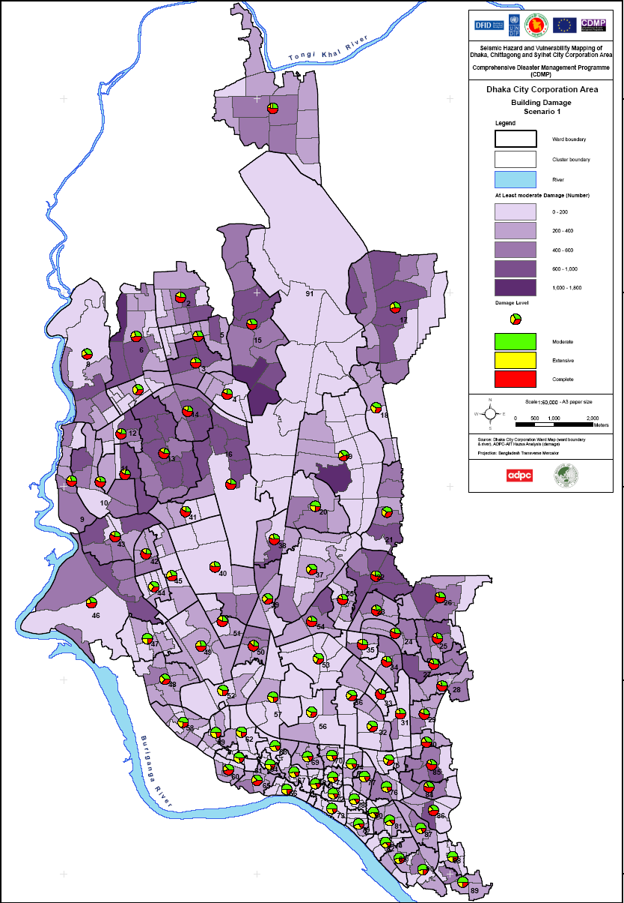
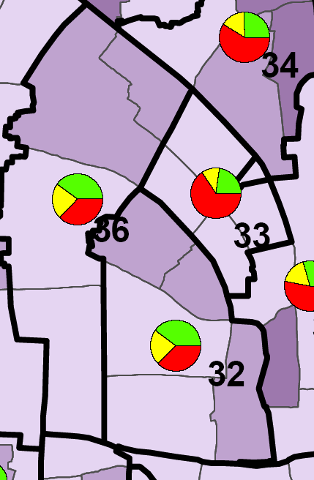
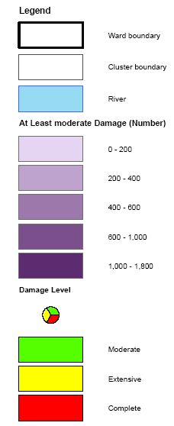
Building Damage Scenario in Ward 32
WARD | CLUSTER | CONCRETE | MASONRY | OTHER | TOTAL
32 | DCL3201 | 22 | 42 | 5 | 69
 | DCL3202 | 90 | 114 | 25 | 229
 | DCL3203 | 45 | 72 | 8 | 125
 | DCL3204 | 182 | 158 | 34 | 374
 | DCL3205 | 68 | 145 | 5 | 218
 | Total | 407 | 531 | 77 | 1015
WARD ID | Moderate | Extensive | Complete
32 | 406 | 229 | 380

Slide 18
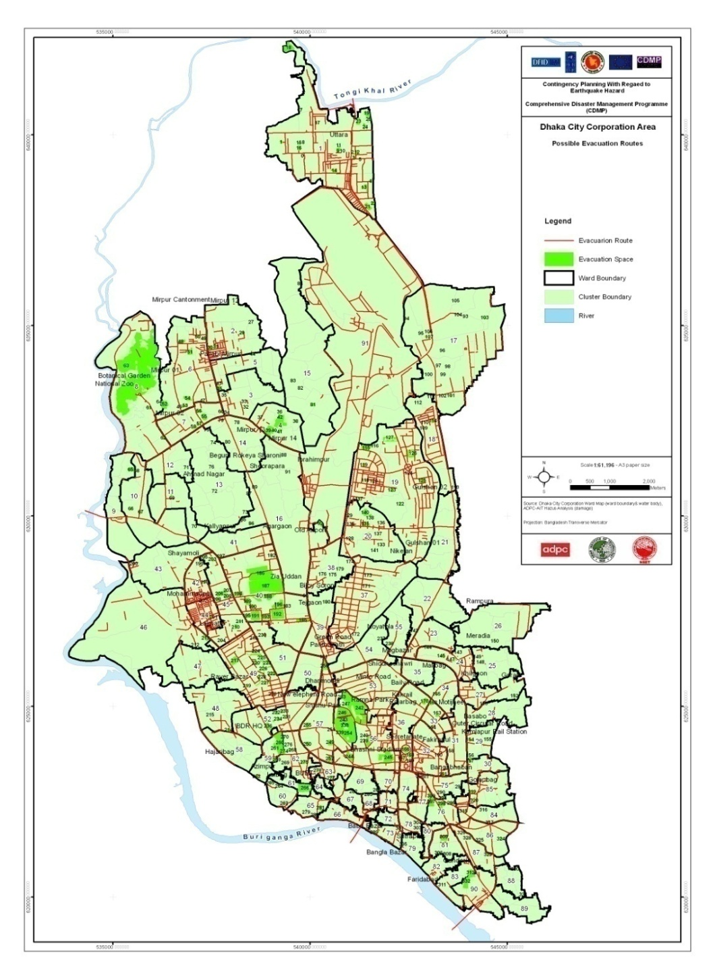
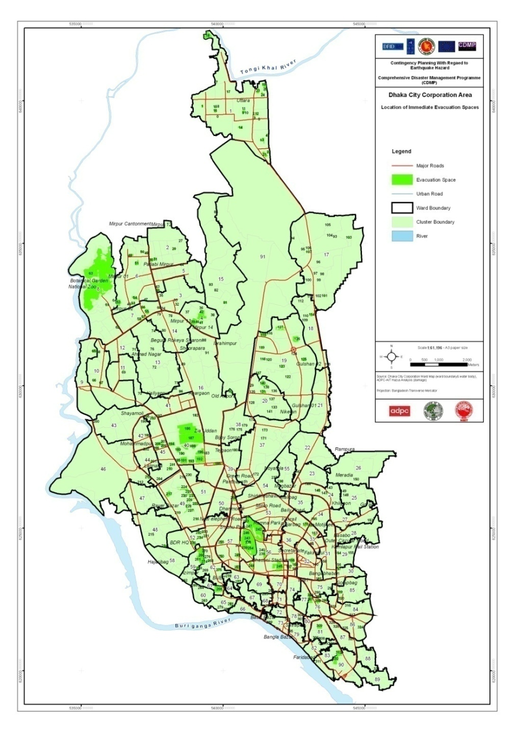
Spatial Contingency Plan
Possible Evacuation Route in Dhaka City
Evacuation Space in Dhaka City

Slide 19
Challenges
Knowledge gap
Complexities in urban setting and mindset of city dwellers and public representative
Lack of organizational capacity
Mechanism of institutionalizing the initiatives
Absence of laws/by laws, policies and guidelines
Follow Up Action
More advocacy and campaign for political commitment
Developing the SOP to implement the existing laws/by laws
Undertaking and implementing more community-based programme
Ensure more involvement of the politician and decision makers
More education progarmme for the relevant professional

Slide 20
Public-Private Partnership for Urban Sustainability

Slide 21
Partnership Model
CER (carbon credits)
International Market
Compost
Rural Farmers
Project Investment Harnessing CDM
ACI Fertilizer
BOI
Private Waste Collector
COMPOST PLANT Joint Venture WCC-WWR,FMO, Hightide
Urban Population
CDM Board
Project Approval
Organic Waste
Direct Collection from Vegetable markets
Waste Collected from Households
Promoting source separation and community participation
DCC
Signed concession agreement for15 years
Attracted 12 Million Euro Foreign Direct Investment
PUBLIC
PRIVATE
COMMUNITY
BOI-Board of Investment; DCC-Dhaka City Corporation; PPCP- Public Private Community Partnership

Slide 22
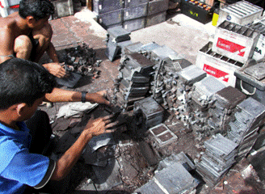
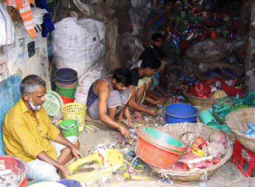
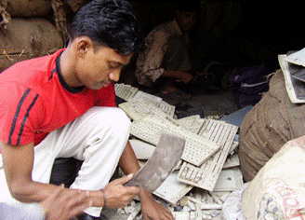
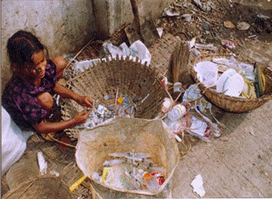
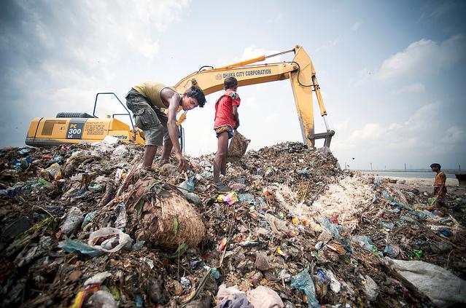
Urban Waste: Present Situation
New Types of Waste Emerging in the Waste Stream
Source of Waste
Mixed Waste
Waste Bins Demountable Containers
Transfer Stations
Used Lead Acid Battery
E-Waste
Plastic Waste
Bio-medical Waste
Rapidly changing consumption patterns are generating significantly increasing proportions of toxic chemicals in industrial waste, hazardous hospital waste, large quantities of electronic waste is a growing concern for Bangladesh
Landfill
PROBLEMS
High organic matter >>(more than 70%)
High moisture content >>(more than 50%)
Low calorific value >>(less than 1000 Kcal/Kg)
Water Pollution
Spread of Disease Vectors
Green House Gas Emission
Odor Pollution
More Land Required for Landfill
Waste Collection Efficiency (urban areas) : 50% (Average)

Slide 23
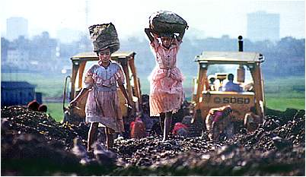
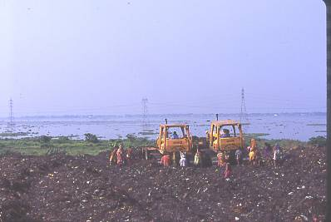
PROBLEMS FROM PRESENT PRACTICE
Solid Waste Management is based on end-of-pipe solution which is only focused on collection, transportation and final disposal…
VERMINS
Spreading more than
40 Diseases
LEACHATE
Polluting Ground
& Surface Water
METHANE GAS
Bad Odor &
Green House
gas
Open dumping practiced in most of the cities and towns, which is the cheapest and easiest solution for them...

Slide 24
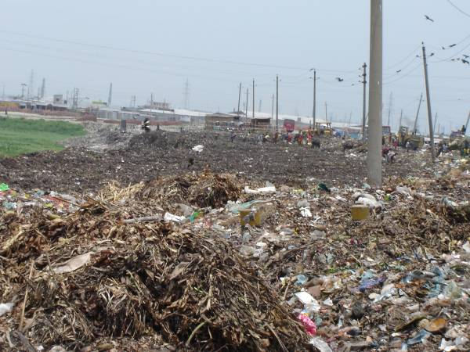
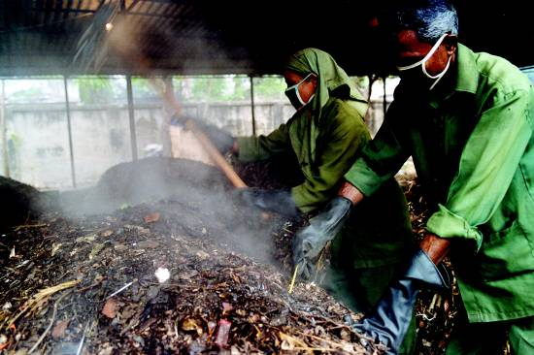
Decentralized Approach of Composting Using Carbon Credits
Baseline Situation
Methane Emission
CDM project
No Methane Emission
City Authorities Collecting
Waste
Existing Practice: land filling of waste
Registered 700 tons/day Compost Plant with UNFCCC
The project is recycling organic vegetable waste and instead of
disposing in landfill, it is converted Into compost.

Slide 25
Way Forward
Urban Environment and Climate Change
Massive investment in basic services is needed to improve the sustainability in decentralized urban development
The energy efficiency of transport system should be addressed and monitored. Energy efficient building designs and building materials should be promoted to reduce greenhouse gas emission.
Solid waste can be used as a resource, as demonstrated in many cities
Need more capital spending on urban infrastructure.
Give priority to better urban planning and management of urban development, improvements to environmental management & better environmental governance.

Slide 26
Urban Governance, management and Finance
Urban governance initiatives should be directed to smaller urban settlements, in the process stimulating development in adjoining rural areas
Well formulated, well-executed city cluster development schemes can bring a number of benefits, including much needed employment and integrated urban infrastructure and services
Mixed system of government, well placed to bring about more comprehensive planning, mobilize appropriate financial resources, improve management efficiency, and involve the private sector
New urban planning and governance structure
If urban governance is to be effective & sustainable, devolution of authority & power to urban local governments is needed, along with adequate financial, revenue-raising & human capacities.
Decentralization requires central government support to avoid excessive regional disparities
Local governments associations should promote city-to-city (C2C) cooperation for to support and exchange of lessons learnt and good practices.

Slide 27
Poverty and inequality in cities
Governments should continue to invest in slum upgrading and low-cost housing, and to upscale pilot projects into national programmes
Governments should review urban land policies to make residential land more accessible and affordable to low and middle-income households
Local authorities should avoid unlawful evictions which destroy the social fabric of poor neighborhoods. Slum eradication, where necessary, should be combined with fair relocation and compensation schemes
People’s process of housing and slum improvement should be encouraged by all levels of government through training, financial incentives and legal recognition.
Government should take necessary steps to ensure safe water supply and to ensure improved sanitation for all residence, and monitor progress on a regular basis.

